Slide 1
OS Admin
Processes - Linux

Slide 2
Module objectives
After completing this module you will be able to:
Describe what a process is and how it is created.
Use Signals to control processes
Use tools to get information about processes
Influence the allocation of the CPU resource to processes.
Define a process thread.

Slide 3
Controlling Processes
Overview Of Processes
Information about Processes
Process Communication - Signals
Process Prioritisation
Process Scheduling
Summary

Slide 4
What is a process?
Linux like any operating system is a collection of smaller programs
Each program provides some of the operating system’s functionality
A process is an instance of a program running or a program in execution.
Applications running in Linux can consist of one or more processes. They can be started by the system (i.e. Daemons) or started by the user (i.e. Jobs).
In order to do work they utilise memory and CPU.
They need to be managed!

Slide 5
A process is a program actually executing.
Process, the program in the heat of execution.
CPU
Memory
Disk
Load
Program as a disk file.

Slide 6
Threads
A process is a collection of one or more threads.
A thread is the smallest runnable stream of CPU instructions.
A CPU core divides its time up between different threads.
The CPU core constantly switches from thread to thread to give the appearance of multi-tasking. This is called ‘Time Slicing on the CPU’.

Slide 7
Why control Processes?
Every process uses resources from RAM and CPU.
Most of the time processes only use what they need and release resources once they’ve finished with them.
Occasionally a process proves to be pathological and may end up hogging a large proportion of the RAM or CPU.

Slide 8
The Process Table
The process table contains details of all processes currently running on the system.
It reports on what system resources have been allocated to each process, this information can be used by the system to decide what further resources can be allocated..
You can see an extract of the information in the table using the top or ps commands.
When a process terminates it is removed from the process table. The process frees up RAM and CPU resources for other processes when it terminates.

Slide 9
Parents and Children
When a command, task or application starts it is created by an existing process called ‘The Parent’.
The Parent may create one or more sub-processes, called children. The child process is created using a ‘system call’ called ‘fork’.

Slide 10
Process Creation
Parent
Fork
Parent
Wake
Parent
sleeps
Signal with exit status.
Child

Slide 11
Process creation - detail
Parent Process
Eg bash
Parent Process
Eg bash
Fork
Copy of
Parent Process
Still bash code.
Parent code
Overwritten
By new code
Exec
New-prog

Slide 12
Process creation - detail
When the children have finished they return a result code or exit status back to the parent.
The exit status tells the parent if the child was able to perform the task or not.
The child is then supposed to disappear (i.e. the entry in the process table is deleted.)

Slide 13
Zombie Processes
If something goes wrong with the child process returning its exit status to the parent, the ‘tidy up’ of the process table may not take place
If this happens it leads to a meaningless entry in the process table and, as a result, misleading ps command info about the process.
Such a process is called a zombie!

Slide 14
Process state diagram.
Waiting for a device, or an
event take place event?
Sleep – D/S
Stopped - T
signal
Running or
Runnable - R
signal
signal or exit.
Terminating - Z

Slide 15
Quiz Questions

Slide 16
What is a Linux process?
A unit of hardware capable of executing instructions.
An area of memory.
An executing program.
A disk file capable of being loaded into memory and run.
A device.

Slide 17
What is a Linux process?
A unit of hardware capable of executing instructions.
An area of memory.
An executing program.
A disk file capable of being loaded into memory and run.
A device.

Slide 18
The operation which launches a process is called?
A knife
A split
A fork
A regenerative execution.

Slide 19
The operation which launches a process is called?
A knife
A split
A fork
A regenerative execution.

Slide 20
Which are terms used to describe processes?
Restive
Child
Owner
Owned
Parent

Slide 21
Which are terms used to describe processes?
Restive
Child
Owner
Owned
Parent

Slide 22
Initially, a new process is a copy of the parent code. True/False?

Slide 23
Initially, a new process is a copy of the parent code. True/False? True

Slide 24
Which is true?
A process is created by a fork which copies the code of the parent process, which is then overwritten by the code of the command in question.
A process fork is the creation by the CPU of memory to house the process copied from an empty kernel structure. The code is written into this specially created area of memory.
The code to be executed is first loaded into RAM and then allocated a Process ID, finally the code is laid out in pages and then executed.

Slide 25
Which is true?
A process is created by a fork which copies the code of the parent process, which is then overwritten by the code of the command in question.
A process fork is the creation by the CPU of memory to house the process copied from an empty kernel structure. The code is written into this specially created area of memory.
The code to be executed is first loaded into RAM and then allocated a Process ID, finally the code is laid out in pages and then executed.

Slide 26
Which are process states as reported by the ps command?
Running / Runnable - R
Sleeping – S/D
Slipping - S
Executing - E
Zombie/Terminating - Z
Vampire - V
Stopped - T

Slide 27
Which are process states as reported by the ps command?
Running / Runnable - R
Sleeping – S/D
Slipping - S
Executing - E
Zombie/Terminating - Z
Vampire - V
Stopped - T

Slide 28
A process is in the state 'Running'. To which states might it now transition?
Running / Runnable - R
Sleeping – S/D
Slipping - S
Executing - E
Zombie/Terminating - Z
Vampire - V
Stopped - T

Slide 29
A process is in the state 'Running'. To which states might it now transition?
Running / Runnable - R
Sleeping – S/D
Slipping - S
Executing - E
Zombie/Terminating - Z
Vampire - V
Stopped - T

Slide 30
Controlling Processes
Overview Of Processes
Information about Processes
Process Communication - Signals
Process Prioritisation
Process Scheduling
Summary

Slide 31
The ps command
The ps command can be used for listing processes.
[trainee@Linux ~]$ ps
[trainee@Linux ~]$ ps
PID TTY TIME CMD
11210 pts/27 00:00:00 bash
11238 pts/27 00:00:00 ps
[trainee@Linux ~]$
Unique ID
Command
Notes:
On execution of the command a process was spawned, the command was executed and on this occasion the result has been outputted to standard out (stdout)
The 4 headings are
PID – The unique process id
TTY - Terminal associated with the process
TIME - Total CPU usage
CMD – The command
Note! The processes displayed in this output are the only active ones for this user.
31

Slide 32
Key
These headings are
PID – The unique process id
TTY - Terminal associated with the process
TIME - Total CPU usage
CMD – The command

Slide 33
Listing processes using ps
ps has several options:
ps shows processes associated with the current logon
ps –ef shows all (every) processes, full detail.
ps –fu <UID> shows processes associated with a specific user

Slide 34
Long verses Full
ps –f gives a full output with various useful stats
$ ps -f
UID PID PPID C STIME TTY TIME CMD
fdm 14125 14097 0 08:55 pts/0 00:00:00 bash
fdm 25429 14125 0 14:26 pts/0 00:00:00 ps -f
ps –l gives a long output with various useful stats
$ ps -l
F S UID PID PPID C PRI NI ADDR SZ WCHAN TTY TIME CMD
0 S 1000 14125 14097 0 80 0 - 29053 do_wai pts/0 00:00:00 bash
0 R 1000 25444 14125 3 80 0 - 38309 - pts/0 00:00:00 ps

Slide 35
Finding the PID for a process
Many commands for controlling processes require that you know the PID of the process.
Use the following command to find the PID:
pgrep <process name>
e.g. pgrep cron

Slide 36
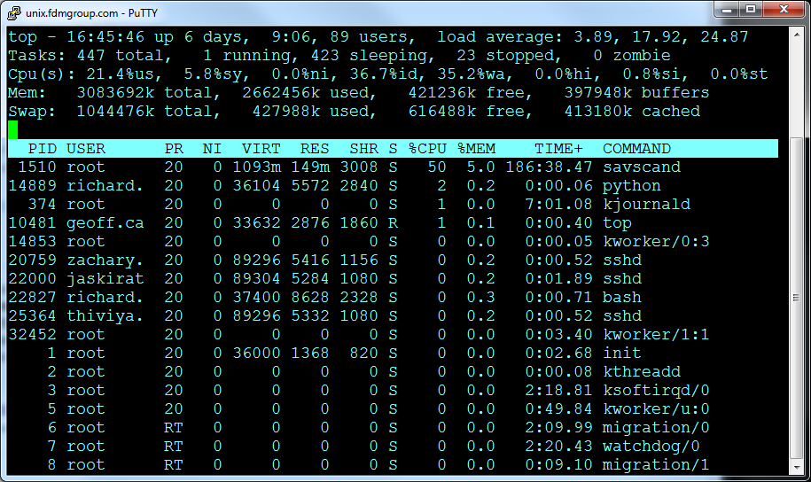
Listing Processes
The top command can be used to list details of all processes currently running. This is done in real-time.
It is very similar to the processes tab of the Task Manager in Windows.

Slide 37
What top lists:
PID – A unique number identifying each process.
USER – The user running the process.
PR – Priority, how important the task is.
NI – The “nice” value. Used in priority computation.
Virt/Res/Shr – Memory usage information.
S – The state of the process, described later.
%CPU – How big a share of a single CPU core the process is using.
%Mem – Its share of available memory.
TIME – The cumulative CPU time the process has used..

Slide 38
What top lists:
The total amount of time the system has been booted including hours and minutes.
top - 16:57:49 up 6 days, 9:18
89 users,
The number of users currently logged.
load average: 2.43, 3.88, 12.81
The average size of the queue for the CPU. Averaged over 1, 5 and 15 minutes. Here we see that over the last 1 minute on average more than 2 processes have been ready to run. (The machine in question had 2 cpu cores, so both cores would have been busy.) A third process was ready to run and waiting for about 43% of the time. The average over the last 5 minutes indicates that at least one process was ready and waiting for CPU, whilst two were actually being processed. You cannot say whether the figure is good or bad unless you know the number of cpu cores. If the queue size is a lot larger than the number of cores the CPU is overcommitted but even this state has its subtleties.

Slide 39
What top lists:
top - 16:57:49 up 6 days, 9:18, 89 users, load average: 2.43, 3.88, 12.81
Tasks: 437 total, 1 running, 413 sleeping, 23 stopped, 0 zombie
Here is an attempt to summarise the process table, giving the number of processes and their distribution over the various states.

Slide 40
What top lists:
top - 16:57:49 up 6 days, 9:18, 89 users, load average: 2.43, 3.88, 12.81
Tasks: 437 total, 1 running, 413 sleeping, 23 stopped, 0 zombie
Cpu(s): 14.7%us, 7.7%sy, 0.0%ni, 37.2%id, 40.1%wa, 0.0%hi, 0.3%si, 0.0%st
A description of some of the places that the cpu time is going:
us = user applications. (The reason you have the machine in the first place).
sy = System. The amount of time the CPU has spent on kernel tasks and the like, e.g. exchanging data with devices.
ni = Time spent running niced processes where the user has helped define the process priority.

Slide 41
Subcommands for top
It is possible to alter the display whilst top is running using built in commands, usually tied to keyboard character:
H Lists threads instead of process stats in the header.
E Changes the unit used in memory stats. Repeated use cycles through KiB to PiB
1 Toggles the CPU summary between single CPU and multi CPU detail.
Many more commands exist, such as:
L Search for a string

Slide 42
Quiz Questions

Slide 43
Which commands allow us to look at process stats/attributes?
ps
date
who
top
bottom
middle

Slide 44
Which commands allow us to look at process stats/attributes?
ps
date
who
top
bottom
middle

Slide 45
The ps command with no arguments will?
Exit the shell.
Show all system processes.
Show only current processes in full detail.
Show only current processes in basic detail.

Slide 46
The ps command with no arguments will?
Exit the shell.
Show all system processes.
Show only current processes in full detail.
Show only current processes in basic detail.

Slide 47
ps -u xxx
Will undo the specified process xxx, ie reverse its effects.
Show all processes running on the system associated with a specific user, user xxx in this case.
Show the current processes that are assocaited with user xxx.
Show unbound processes. That is processes that are not bound to a CPU right now.

Slide 48
ps -u xxx
Will undo the specified process xxx, ie reverse its effects.
Show all processes running on the system associated with a specific user, user xxx in this case.
Show the current processes that are assocaited with user xxx.
Show unbound processes. That is processes that are not bound to a CPU right now.

Slide 49
What does ‘ps –e’ do?
Lists processes which are ending.
Lists processes in the zombie state.
Lists every process on the system.
Lists every process belonging to the current user.
Lists processes in full detail.

Slide 50
What does ‘ps –e’ do?
Lists processes which are ending.
Lists processes in the zombie state.
Lists every process on the system.
Lists every process belonging to the current user.
Lists processes in full detail.

Slide 51
What does ps -l do?
Lists current processes in long detail, i.e. with status information, nice value, priority, e.t.c.
Lists all processes in long detail, i.e. with status information, nice value, priority, e.t.c.
Lists all processes with a low nice value.
Lists current processes with a low nice value.

Slide 52
What does ps -l do?
Lists current processes in long detail, i.e. with status information, nice value, priority, e.t.c.
Lists all processes in long detail, i.e. with status information, nice value, priority, e.t.c.
Lists all processes with a low nice value.
Lists current processes with a low nice value.

Slide 53
Which form of the ps command provides more detail, as in a longer list of attributes: ps -f or ps -l

Slide 54
Which form of the ps command provides more detail, as in a longer list of attributes: ps -f or ps –l ps -l

Slide 55
Which command gives a regularly updated view of process status?

Slide 56
Which command gives a regularly updated view of process status? top

Slide 57
Controlling Processes
Overview Of Processes
Information about Processes
Process Communication - Signals
Process Prioritisation
Process Scheduling
Summary

Slide 58
Communicating with a process.
Processes can be interrupted through the use of signals.
A signal interrupts the processes normal flow of execution.
Stopping a process.
Processes can catch signals and respond with a predetermined response which can be anything from ignore the signal completely or terminate. The usual or default response is to terminate. Signals vary in ‘strength’. They are represented by number in the range 0-64, the lower the signal number the ‘stronger’ the signal.
The ‘kill’ command is used to deliver a signal to a process.
kill -9 2345
This delivers a ‘9’ signal to process 2345, this is without fail terminal to the process.

Slide 59
How to pause a process
Use kill to send signal 19 to pause process.
kill -19 2345
kill –sigstop 2345
Note process 2345 will be in the ‘T’ state.
Use kill to send signal 18 to release.
kill -18 2345
kill –sigcont 2345
kill -sigstop 22202
[1]+ Stopped sleep 1000
kill -sigcont 22202
$ jobs
[1]+ Running sleep 1000 &
Notes:
$ kill -l
1) SIGHUP 2) SIGINT 3) SIGQUIT 4) SIGILL 5) SIGTRAP
6) SIGABRT 7) SIGBUS 8) SIGFPE 9) SIGKILL 10) SIGUSR1
11) SIGSEGV 12) SIGUSR2 13) SIGPIPE 14) SIGALRM 15) SIGTERM
16) SIGSTKFLT 17) SIGCHLD 18) SIGCONT 19) SIGSTOP 20) SIGTSTP
21) SIGTTIN 22) SIGTTOU 23) SIGURG 24) SIGXCPU 25) SIGXFSZ
26) SIGVTALRM 27) SIGPROF 28) SIGWINCH 29) SIGIO 30) SIGPWR
31) SIGSYS 34) SIGRTMIN 35) SIGRTMIN+1 36) SIGRTMIN+2 37) SIGRTMIN+3
38) SIGRTMIN+4 39) SIGRTMIN+5 40) SIGRTMIN+6 41) SIGRTMIN+7 42) SIGRTMIN+8
43) SIGRTMIN+9 44) SIGRTMIN+10 45) SIGRTMIN+11 46) SIGRTMIN+12 47) SIGRTMIN+13
48) SIGRTMIN+14 49) SIGRTMIN+15 50) SIGRTMAX-14 51) SIGRTMAX-13 52) SIGRTMAX-12
53) SIGRTMAX-11 54) SIGRTMAX-10 55) SIGRTMAX-9 56) SIGRTMAX-8 57) SIGRTMAX-7
58) SIGRTMAX-6 59) SIGRTMAX-5 60) SIGRTMAX-4 61) SIGRTMAX-3 62) SIGRTMAX-2
63) SIGRTMAX-1 64) SIGRTMAX

Slide 60
How to terminate a process
Use the kill command to terminate a process.
kill [signal] <PID>
e.g. kill 1234 - Process terminated
or kill -9 1234 - Process killed.
...or user pkill to terminate a process by name
The kill command delivers signal 15 by default. This asks the process itself to perform an orderly shutdown. The process may choose to action that or simply to ignore.
If the kill command delivers signal 9, the kernel terminates the process without informing or asking the process. The application would not have performed an orderly shutdown. This kind of termination could lead to the application having to clean up on restart or cause even worse difficulties.

Slide 61
Keyboard signals
Ctrl-C – sends signal 9 to current foreground process.
Ctrl-Z – sends signal 19
Notes:
$ kill -l
1) SIGHUP 2) SIGINT 3) SIGQUIT 4) SIGILL 5) SIGTRAP
6) SIGABRT 7) SIGBUS 8) SIGFPE 9) SIGKILL 10) SIGUSR1
11) SIGSEGV 12) SIGUSR2 13) SIGPIPE 14) SIGALRM 15) SIGTERM
16) SIGSTKFLT 17) SIGCHLD 18) SIGCONT 19) SIGSTOP 20) SIGTSTP
21) SIGTTIN 22) SIGTTOU 23) SIGURG 24) SIGXCPU 25) SIGXFSZ
26) SIGVTALRM 27) SIGPROF 28) SIGWINCH 29) SIGIO 30) SIGPWR
31) SIGSYS 34) SIGRTMIN 35) SIGRTMIN+1 36) SIGRTMIN+2 37) SIGRTMIN+3
38) SIGRTMIN+4 39) SIGRTMIN+5 40) SIGRTMIN+6 41) SIGRTMIN+7 42) SIGRTMIN+8
43) SIGRTMIN+9 44) SIGRTMIN+10 45) SIGRTMIN+11 46) SIGRTMIN+12 47) SIGRTMIN+13
48) SIGRTMIN+14 49) SIGRTMIN+15 50) SIGRTMAX-14 51) SIGRTMAX-13 52) SIGRTMAX-12
53) SIGRTMAX-11 54) SIGRTMAX-10 55) SIGRTMAX-9 56) SIGRTMAX-8 57) SIGRTMAX-7
58) SIGRTMAX-6 59) SIGRTMAX-5 60) SIGRTMAX-4 61) SIGRTMAX-3 62) SIGRTMAX-2
63) SIGRTMAX-1 64) SIGRTMAX

Slide 62
Quiz Questions

Slide 63
A linux signal is generally a way of:
Raising an error alert.
Increasing process niceness
Communicating with a process
Getting process status information.

Slide 64
A linux signal is generally a way of:
Raising an error alert.
Increasing process niceness
Communicating with a process
Getting process status information.

Slide 65
Which commands send signals?
sig
kill
signal
flag
pkill
dispatch

Slide 66
Which commands send signals?
sig
kill
signal
flag
pkill
dispatch

Slide 67
What does the TERM (15) signal do to a process?
Destroy the process with dispatch.
Suspend the process
Release the process
Ask the process to run its normal exit routine.

Slide 68
What does the TERM (15) signal do to a process?
Destroy the process with dispatch.
Suspend the process
Release the process
Ask the process to run its normal exit routine.

Slide 69
What does the KILL (9) signal do to a process?
Destroy the process with dispatch.
Suspend the process
Release the process
Ask the process to run its normal exit routine.

Slide 70
What does the KILL (9) signal do to a process?
Destroy the process with dispatch.
Suspend the process
Release the process
Ask the process to run its normal exit routine.

Slide 71
Which two correctly describe the difference between 'kill -9 8844' & 'kill 8844'
The plain kill command has signal strength 15 which is stronger than the 'kill -9' signal.
Both forms of the kill command are the same.
The 'kill -9' command has signal strength which is stronger than the plain kill command.
The 'kill -9' command will give rise to the 'killed' message as the process ends, the plain kill command 'terminated'.
The 'kill -9' command will give rise to the 'terminated' message as the process ends, the plain kill command 'killed'.

Slide 72
Which two correctly describe the difference between 'kill -9 8844' & 'kill 8844'
The plain kill command has signal strength 15 which is stronger than the 'kill -9' signal.
Both forms of the kill command are the same.
The 'kill -9' command has signal strength which is stronger than the plain kill command.
The 'kill -9' command will give rise to the 'killed' message as the process ends, the plain kill command 'terminated'.
The 'kill -9' command will give rise to the 'terminated' message as the process ends, the plain kill command 'killed'.

Slide 73
Controlling Processes
Overview Of Processes
Information about Processes
Process Communication - Signals
Process Prioritisation
Process Scheduling
Summary

Slide 74
Process Prioritisation
The scheduler decides which process to run next.
There could be a number of processes in a runnable state but only one available cpu core. Which one to run?
Process priority
Each process has an assigned ‘priority’ – a number which helps the scheduler decide which to run. Counter intuitively, the higher the priority number the lower the chances of the process has of being run but the bigger the time-slice it will get when it does run.

Slide 75
Linux CPU scheduling
Priority
Large time slice
100
Less
chance of CPU attention.
Small time slice.
20
Good chance of running on the CPU

Slide 76
Process Prioritisation
Users can affect the scheduling calculation!
Users are allowed to assign processes ‘nice’ values, from 0-19. This value adds to the priority number in the scheduling calculation thus making it less likely to run.
Administrators can affect the scheduling calculation!
Administrators are allowed to assign negative nice values, thus promoting a process in the CPU allocation stakes. They can use values -20 to +19, either promoting or demoting the process in its claim for CPU time..

Slide 77
The nice/renice command
A command can be launched using ‘nice’
$ nice -n 10 ./loop &
[3] 26825
[fdm@fdm ~]$ ps -lp26825
F S UID PID PPID C PRI NI ADDR SZ WCHAN TTY TIME CMD
0 S 1000 26825 18591 0 90 10 - 28294 do_wai pts/2 00:00:00 sh
The priority of this process would normally read ‘80’ but reads 90 dues to the nice value.
Notes:
Process priority values are reported in different ways by different commands. The ‘real’ values run from 0-139, where 139 is the lowest priority and 0 the highest. These are the priorities as reported by various commands.
Real Priority top ps -lp <pid> ps -p <PID> -o pri Nice Value
20 80 19 0
125 25 85 14 5
39 99 0 19
The real priority is found through
grep prio /proc/<PID>/sched

Slide 78
The nice/renice command
A running process can can be reniced.
$ renice -n 15 -p 26825
26825 (process ID) old priority 10, new priority 15
$ ps -lp26825
F S UID PID PPID C PRI NI ADDR SZ WCHAN TTY TIME CMD
0 S 1000 26825 18591 0 95 15 - 28294 do_wai pts/2 00:00:00 sh

Slide 79
Quiz Questions

Slide 80
Deciding which process to run next, i.e. scheduling is complicated. Some influence on this decision can be exerted by a value associated with the process called?
nice
niece
nasty
importance

Slide 81
Deciding which process to run next, i.e. scheduling is complicated. Some influence on this decision can be exerted by a value associated with the process called?
nice
niece
nasty
importance

Slide 82
Which nice value will give a process the best chance of jumping to the front of the queue
10
0
-13
-20
19

Slide 83
Which nice value will give a process the best chance of jumping to the front of the queue
10
0
-13
-20
19

Slide 84
Which command would enable you to affect the the relative share of CPU resource allocated to an already running process.
top
ps
chpri
nice
renice
chmod

Slide 85
Which command would enable you to affect the the relative share of CPU resource allocated to an already running process.
top
ps
chpri
nice
renice
chmod

Slide 86
Controlling Processes
Overview Of Processes
Information about Processes
Process Communication - Signals
Process Prioritisation
Process Scheduling
Summary

Slide 87
The crond utility
⏰
The crond utility is used to schedule processes that take place on a regular basis (i.e. Every day or every week).
Common uses of crond include
Scheduling backups
Scheduling removal of temporary files
Scheduling regular reminders

Slide 88
CRONTAB files
Lists of scheduled processes are stored in ‘Crontab’ files.
Users may have their own crontab file, stored in /var/spool/cron
Root can also have a file in /var/spool/cron to allow jobs to be scheduled to run as ‘root’.
Crontab system file can be found in /etc/crontab
Root can edit this file to add the scheduled tasks.
cron.daily, cron.hourly, cron.weekly and cron.monthly directories, contain scripts to run accordingly (once every day or every month or every hour).

Slide 89
Contents of crontab files
Each line in a crontab file represents a single process to schedule.
There are five fields that allow you to specify when and how often a process is to be scheduled.
vi /etc/crontab
Notes:
We need to mention the user name that represents the user account that will be used to run the command or script
You can schedule command or script, redirect the output to a file otherwise the output will be mailed to the user mentioned in the MAILTO varaiable.

Slide 90
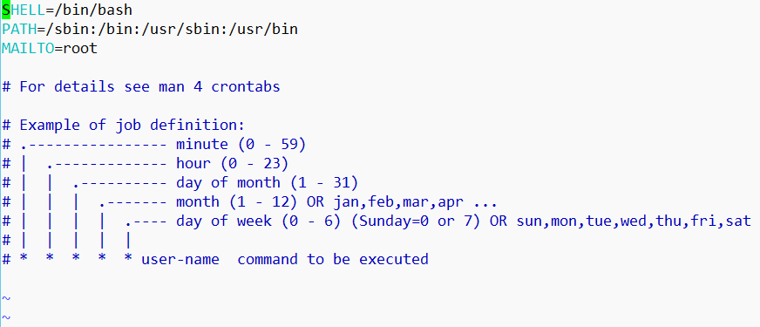
Contents of crontab files
Notes:
We need to mention the user name that represents the user account that will be used to run the command or script
You can schedule command or script, redirect the output to a file otherwise the output will be mailed to the user mentioned in the MAILTO variable.

Slide 91
Lines in the crontab file
Field Description Values
1 Minute 0-59 or *
2 Hour 0-23 or *
3 Day of month 1-31 or *
4 Month 1-12 or *
5 Day of week 0-6 or * (0 is Sunday)
6 User-name
7 Command
Example:
0 18 1,15 * * root echo “Update your virus definitions” >/dev/console
Notes:
Example 1: * every minute or */10 --> every 10 mins
Example 2: 1-4 from Monday to Thursday or 1,4 this means Monday or Thursday

Slide 92
Examples of Crontab File Entries
# run five minutes after midnight, every day
5 0 * * * root $HOME/bin/daily.job
# run at 2:15am on the first of every month
15 2 1 * * root $HOME/bin/monthly.job
# run at 10 pm on sundays, reboot the server
0 22 * * 0 root /etc/shutdown -r

Slide 93
Editing crontab file by a normal user
To check if the user has a crontab file using:
crontab –l
To create or edit a crontab file use the following syntax:
crontab –e
To remove the user crontab file:
crontab –r
Notes:
Login as any user and then type crontab –l to see if that user has scheduled tasks, or use crontab –e to schedule a task for this user, or use crontab –r to delete the scheduled task of this user

Slide 94
Limitations Of Crond
crond job syntax does not make it possible to define all possible periods one could think of. E.g. It is difficult to express the last week of the month.
crond job runs on specific time so if the server is down during that time the job won’t run.
Files or directories which are created by crond jobs are only created with default permissions as specified by the umask setting.
Notes:
crond job runs on specific time so if the server is down during that time the job won’t run.

Slide 95
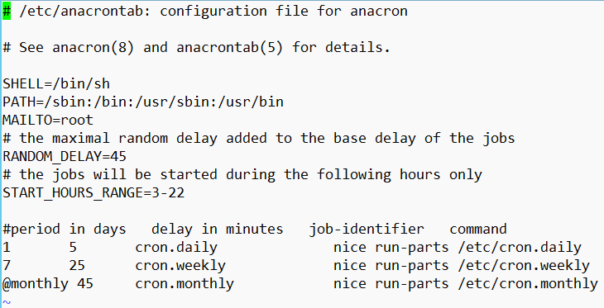
The anacron utility
To schedule a job to run daily, weekly or monthly within a certain delay from the system start-up.
It used exactly like the crond:
vi /etc/anacrontab
Notes:
crond job runs on specific time so if the server is down during that time the job won’t run so to overcome this issue you can use anacron inteasd.
1 = daily and the job will run after 5 minutes from the system startup
7 = weekly

Slide 96
The ‘atd’ utility
The ‘at’ utility allows you to schedule a one off task.
An example of the ‘at’ command might be to send yourself a reminder.
The ‘at’ service must be working to be able to use the ‘at’ command, which we can check using:
We can also deny the use of ‘at’ for certain user by adding that user name to the file /etc/at.deny

Slide 97
The crond and atd system services
These daemons are started at boot time.
System Services are controlled by the systemctl command
systemctl status atd – will show if the atd service is running
systemctl status crond – will show if the crond service is running
The stop the atd service: systemctl stop atd
To start the atd service: systemctl start atd
Similarly for crond

Slide 98
Creating an ‘atd’ job
Use the following syntax:
at <date/time>
and then type each command you want to schedule on separate line
once you finished press Ctrl+d
Example:
at noon
ls /etc > /testAT
Ctrl+d
Notes:
It can be also:
at 4:30pm
at wednesday

Slide 99

Other uses of ‘at’
atq check which jobs are in the at queue.
at –l check which jobs are in the at queue.
at –r <job number> remove an at job.

Slide 100
Quiz Questions

Slide 101
You want to run a backup each Sunday afternoon. If the system is powered off then you do not expect the backup to run. Which system utility would you use?
cron
anacron
at
none of the above

Slide 102
You want to run a backup each Sunday afternoon. If the system is powered off then you do not expect the backup to run. Which system utility would you use?
cron
anacron
at
none of the above

Slide 103
You want to run a backup next Sunday afternoon as a complete one off. Which system utility would you use?
cron
anacron
at
none of the above

Slide 104
You want to run a backup next Sunday afternoon as a complete one off. Which system utility would you use?
cron
anacron
at
none of the above

Slide 105
You want to run a backup each Sunday afternoon. If the system is powered off then you want the process to run soon after it is powered back on. Which system utility would you use?
cron
anacron
at
none of the above

Slide 106
You want to run a backup each Sunday afternoon. If the system is powered off then you want the process to run soon after it is powered back on. Which system utility would you use?
cron
anacron
at
none of the above

Slide 107
You have the cron entry 15 3 * * 0 /opt/auditReconcile Which describes when an how often this program would run?
At 3am on the 15th of each month.
At 3pm on the 3rd of each month.
On Sundays at 15 minutes past three in the morning.
none of the above

Slide 108
You have the cron entry 15 3 * * 0 /opt/auditReconcile Which describes when an how often this program would run?
At 3am on the 15th of each month.
At 3pm on the 3rd of each month.
On Sundays at 15 minutes past three in the morning.
none of the above

Slide 109
Controlling Processes
Overview Of Processes
Information about Processes
Process Communication - Signals
Process Prioritisation
Process Scheduling
Summary

Slide 110
Summary
The system has a process table which holds detailed statistics concerning each process.
Top and ps are just two commands that access and show this information.
Signals can be sent to processes, these can terminate or otherwise affect the process.
Process can be set to run on a scheduled basis, regularly or as a one off.

Slide 111
Summary cont..
The CPU resource is shared out amongst competing processes by the kernel through a scheduling algorithm.
Nice values affect scheduling decisions

